Slide 1
Automated Cartography Solutions (ACS)
Providing A New Automated Mapping Solution

Slide 2
VIDEO
Maybe talk about why we wanted to do this before this slide.

Slide 3
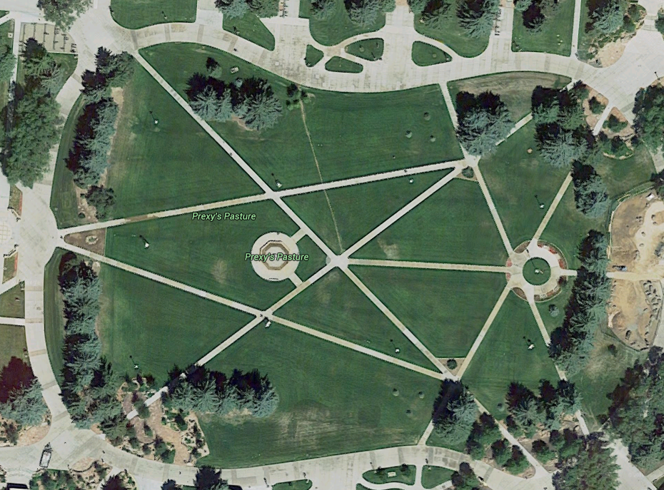
The Problem
Google Maps provides users with satellite images of the world. That is great, but the images are update infrequently (1-3 years)

Slide 4
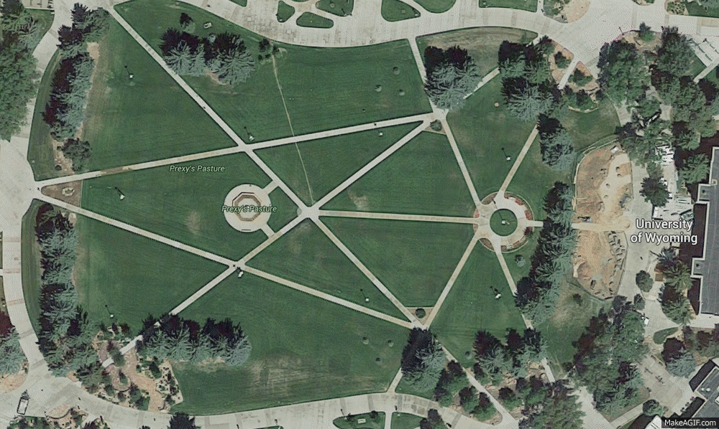
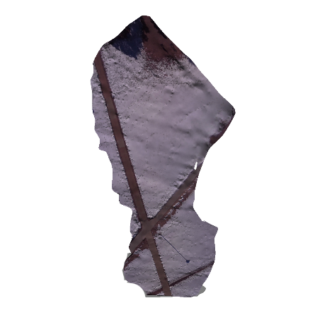
The Solution
Automated Cartography Solutions.
What is required?
A Phone and a Drone

Slide 5
Potential Uses
Who needs more update maps?
Open face mines
Construction companies
Farmers
Disaster Reconnaissance

Slide 6
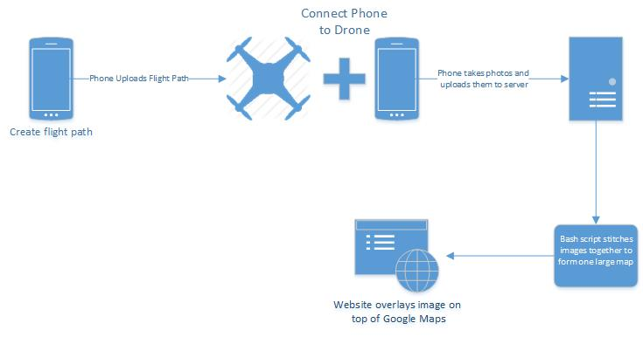
Project Overview

Slide 7
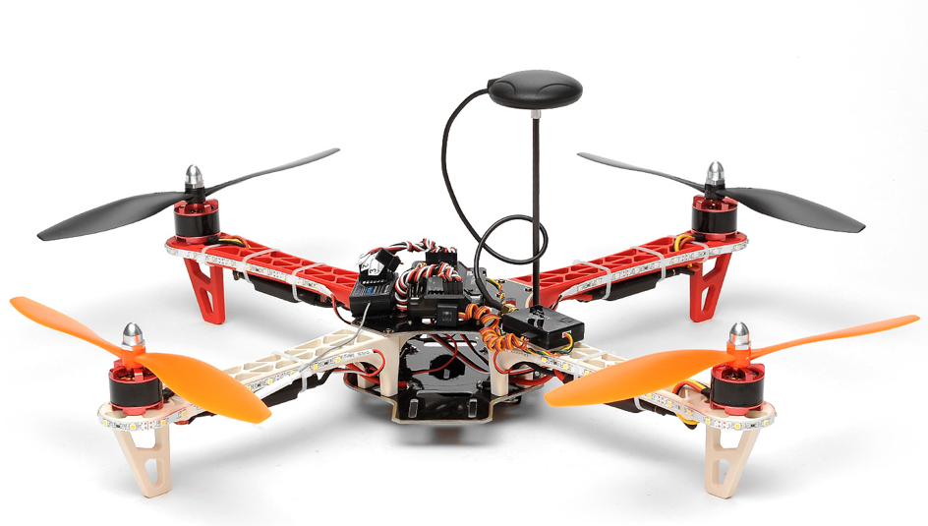
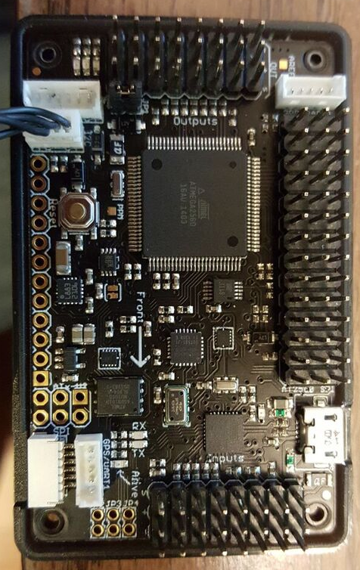
AeroSky P12 Quadcopter
Lipo-Battery
2200 mAh ~ 20 minutes flight time
APM 2.5 Arduino board
Open source
Accelerometer
U-blox NEO-6M GPS module
Accuracy:
Position 2.5 m CEP
SBAS 2.0 m CEP
Notes:
<number>

Slide 8
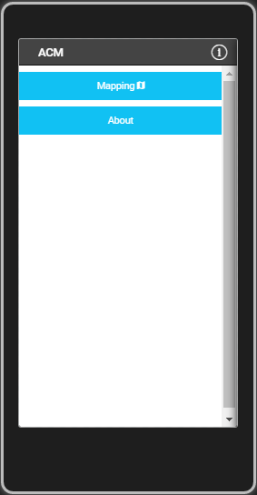
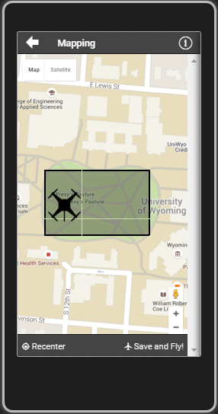
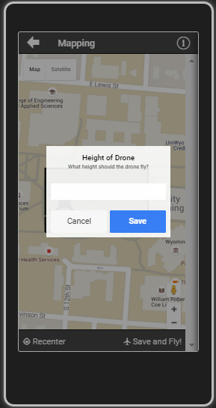
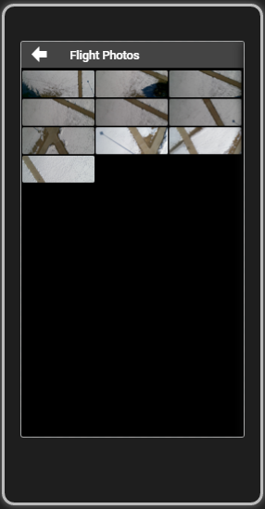
ACS App

Slide 9


Slide 10
App Overview
Cross Platform app utilizing:
AngularJS (1.4)
Apache Cordova (3.5.1)
Ionic(1.2.4)
jQuery
Creates flight path
Takes photo
Upload photos to the server

Slide 11
Server Infrastructure Overview
Need new UML

Slide 12
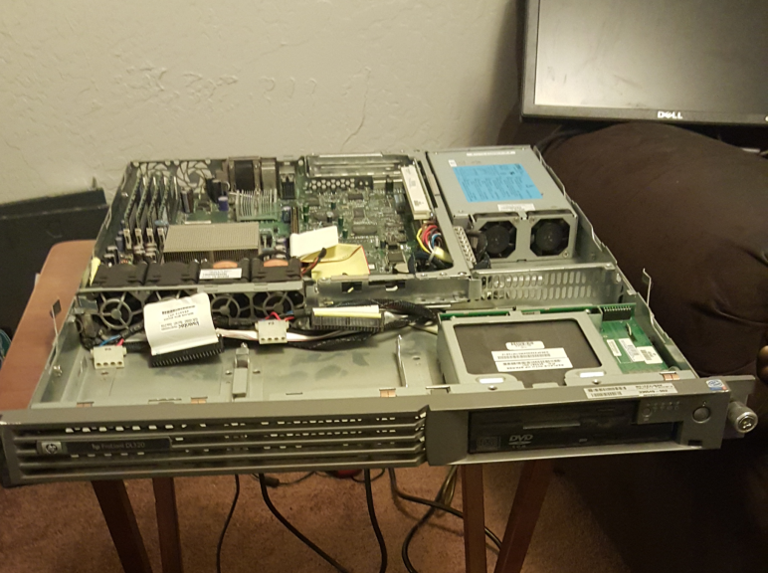
Primary Database Server
Running Windows Server 2012
Uses MySQL
Meta Data
Image Locations
Originally several bash scripts
to process the images on a
Xubuntu server
HP ProLiant DL320

Slide 13
Server Side Code
Formats images to a uniform size
Scrapes image metadata
Enforces image naming conventions
Creates a master image list
Passes images to Autodesk 123D Catch

Slide 14
Autodesk 123D Catch
Creates 3D objects using a large set of images
Originally we created a system using ImageMagick and Javascript
Now we record video with the phone and scrape images from it using VLC Player

Slide 15
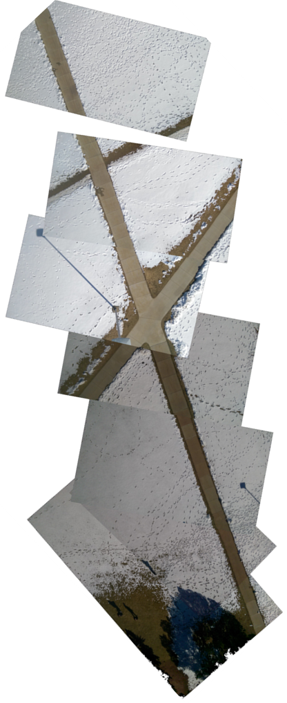
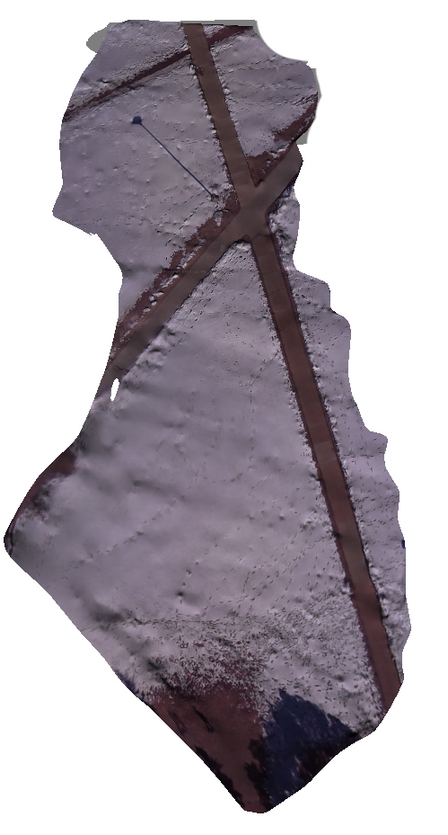
Original map
Autodesk Render

Slide 16
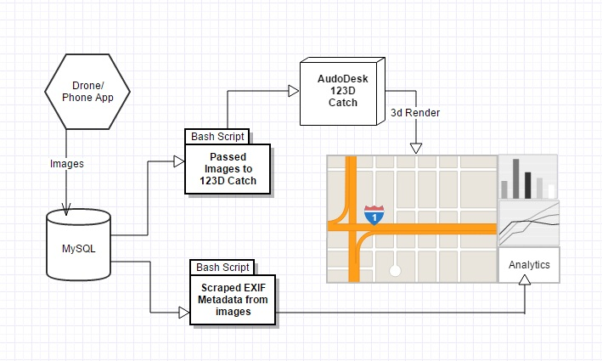
Overview
Change/ remove?

Slide 17
Analytical Information
Average speed
Estimated distance between images
GPS information
EXIF data from picture
Notes:
Could be compiled into an automated report that can be emailed to the user after each flight.
<number>

Slide 18
Reporting Tools
Add Website
Maybe just a ton of logs from Mission Planner

Slide 19
Future Improvements
Low cost hardware upgrades
Sonar
Hexa-Copter
Move software to Cloud
Automatically generated reports
Camera stabilizing mount
Real time video rendering

Slide 20
Q
A
&
Notes:
<number>

